Slide 1
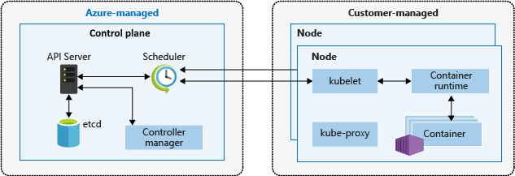
What is Kubernetes?
Kubernetes is a portable, extensible open-source orchestrator platform for automating deployment, scaling, and the management of containerized workloads.
It can run on-premises and public cloud environments
Kubernetes consists of Master and Worker Nodes
Master nodes: Hosts the control plane which is responsible for maintaining the desired state of the cluster
It contains: ETCD, Scheduler, API Server, Controller Manager and Cloud Controller Manager
ETCD: Its Key and value store, it stores data about Kubernetes objects, which aware of any changes in the cluster. Normally, we don’t interact directly but via API Server
API Server:
Worker Nodes: Hosts the date plane, responsible for running the containers in pods. They report status to the control plane (Master Nodes)
Kubernetes cluster contains nodes, deployments, pods, services, daemonsets and various other objects
Pod is a small and simple unit that runs one or more containers and it has unique IP in the clusters
Deployments is an object to control the behavior of similar pods

Slide 2
What is the Azure Kubernetes Service (AKS)?
AKS manages your hosted Kubernetes environment and makes it simple to deploy and manage containerized applications in Azure. Your AKS environment is enabled with features such as automated updates, self-healing, and easy scaling. Azure manages the control plane of your Kubernetes cluster for free. You manage the agent nodes in the cluster and only pay for the VMs on which your nodes run

